Slide 1
Emerging Markets Program
The EMP provides Market America a simple, streamlined process for opening new markets with a very quick time-to-market for those countries
Notes:
Open total 7 new markets – doubled number of countries in 1 yr.

Slide 2
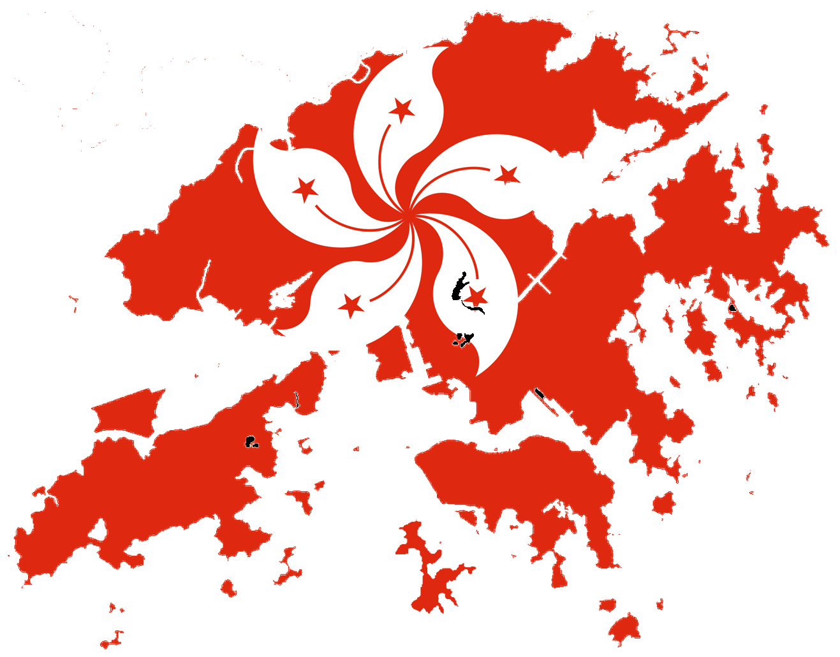
Current Market Countries

Slide 3
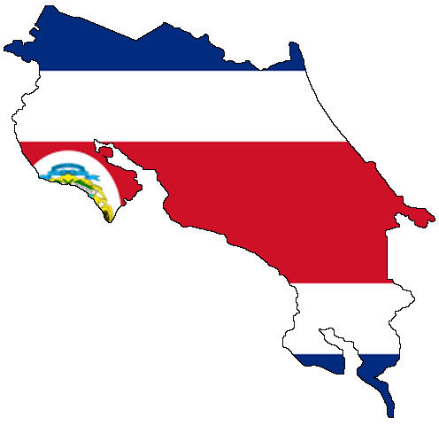
EMP Markets
Spain
Dominican
Republic
Costa Rica
Columbia
Ecuador

Slide 4
Emerging Markets Program
We’ve Doubled Countries in less than 1 Year
Initial EMP country list
Costa Rica
Columbia
Dominican Republic
Ecuador
Spain
Notes:
Open total 7 new markets – doubled number of countries in 1 yr.

Slide 5
Emerging Markets Program
Distributors in all market countries will be able to sponsor distributors in EMP countries
EMP country distributors will be able to sponsor new distributors, earn commissions just like market country distributors
EMP countries get access to BV products (no IBV or partner stores)

Slide 6
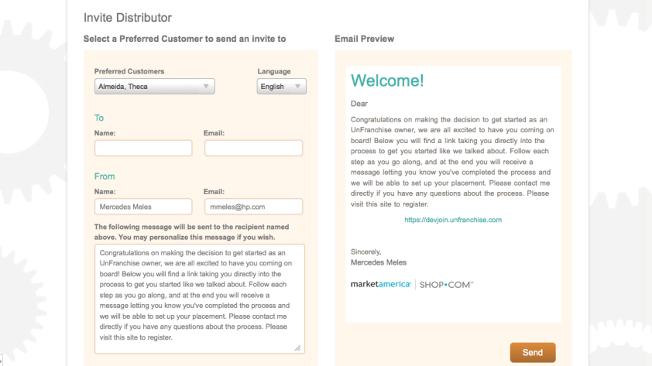
Use Invite Tool To Sponsor
To access the invite tool in Classic UnFranchise, simply access it through the following menu selection:
Other Services → My Organization

Slide 8
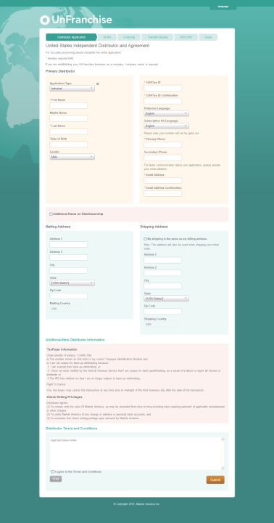
After clicking on the flag, the person you invited will fill out the distributor application and agreement.

Slide 9
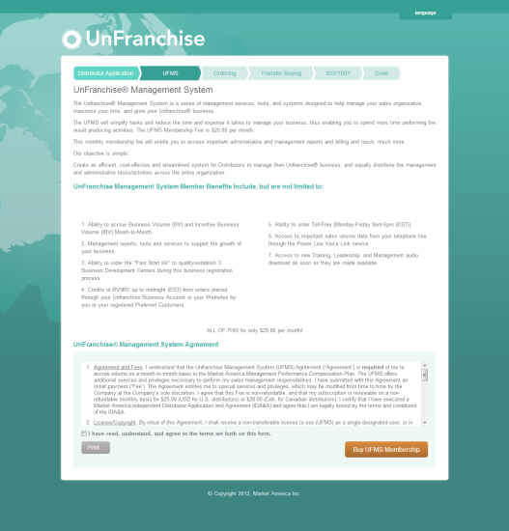
Next, they will complete the UFMS application.

Slide 10
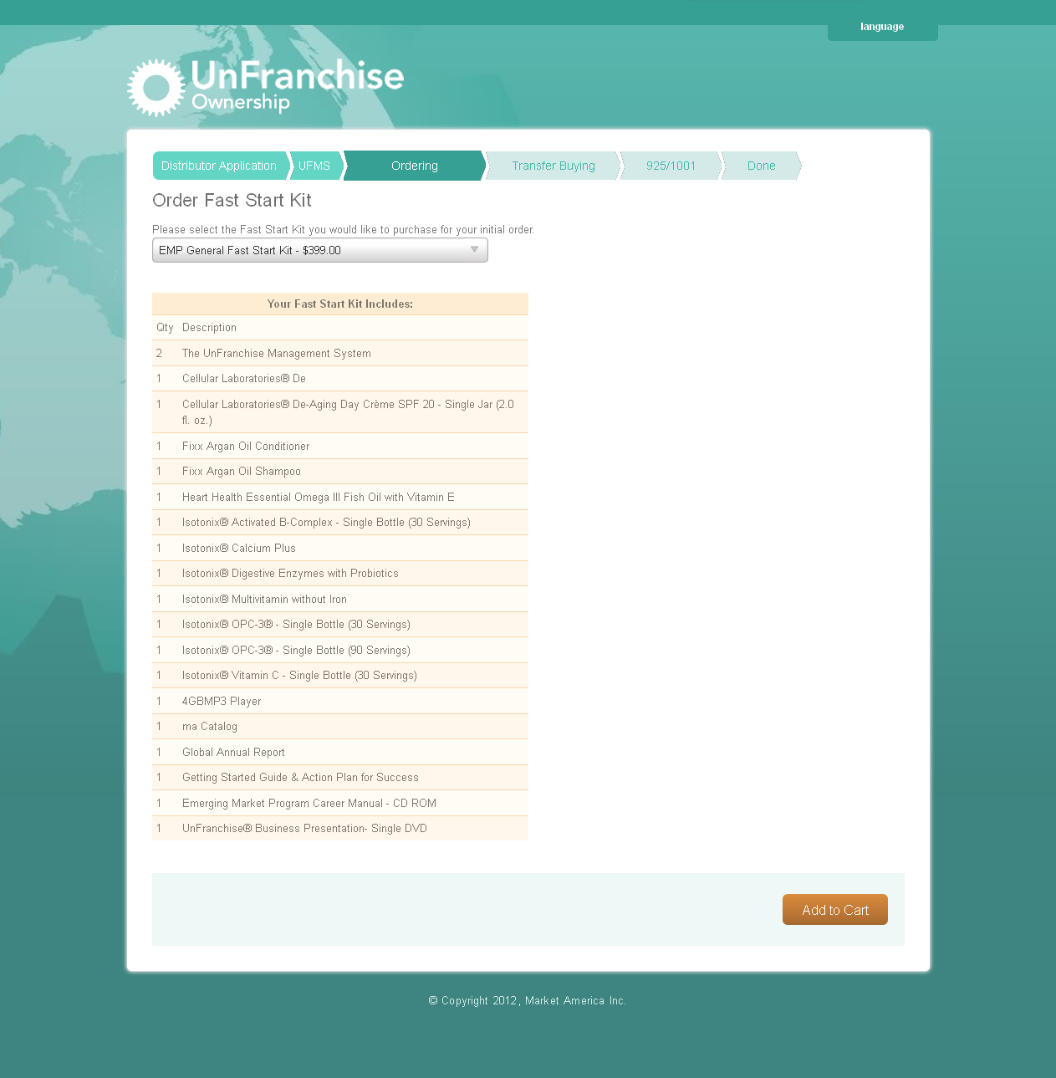
Here we show the EMP Fast Start Kit and the EMP Motives Fast Start Kit.
Supervisory Entry Level
MA Products for Latin American Countries
UK Products for Spain.
Notes:
Update with new fast start kits shots from Jeremy and add product to this page.

Slide 11
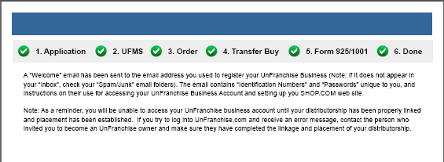
THAT’S IT -- THE NEW EMP DISTRIBUTOR IS NOW A UFO!

Slide 12
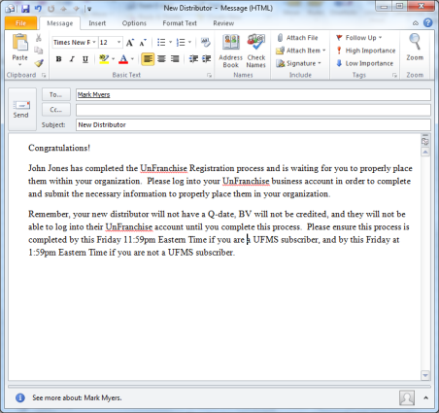
Waiting Room
You will receive an email notification when new recruits complete the signup process.
We will also send an email to your upline Certified Executive Coordinator and upline Professional Coordinator (or higher)

Slide 13
New Ways to Get New Recruits
As the distributor who sent the invite, you will be responsible for activating their account by setting the BDC placement and sponsor information.

Slide 14
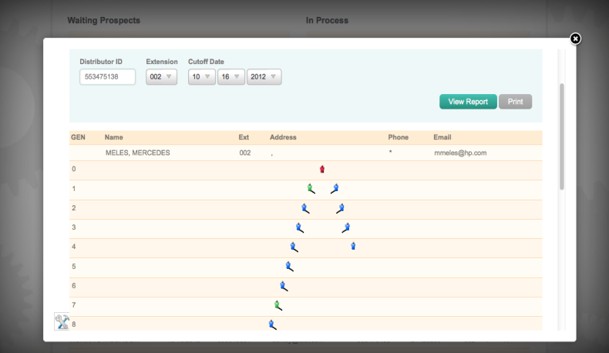
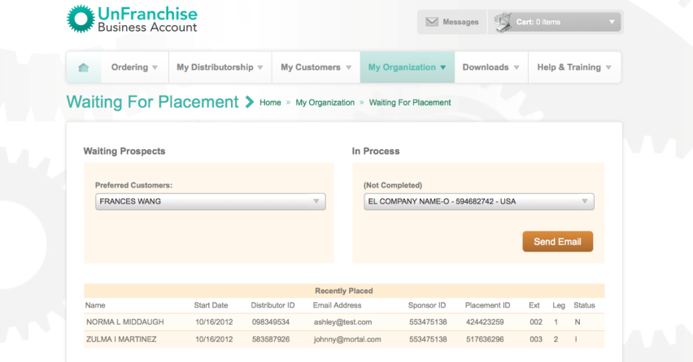
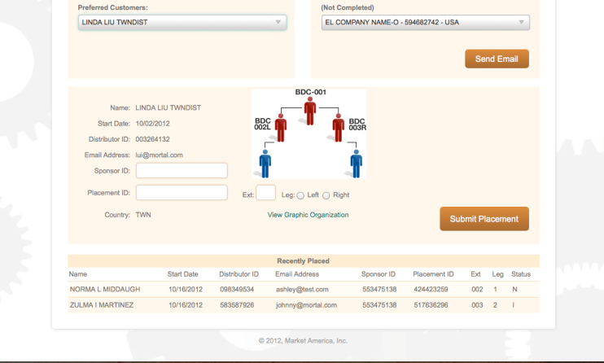
Waiting Room

Slide 15
Waiting Room
With the new Waiting Room, you can invite as many recruits as you want and signup as many as you want at any time.
Now you can have signing parties along with your business plan presentation.

Slide 16
EMP Distributors have a complete back office just like market country distributors.

Slide 17
EMP’s are the first to receive the new UnFranchise Reboot back office!

Slide 18
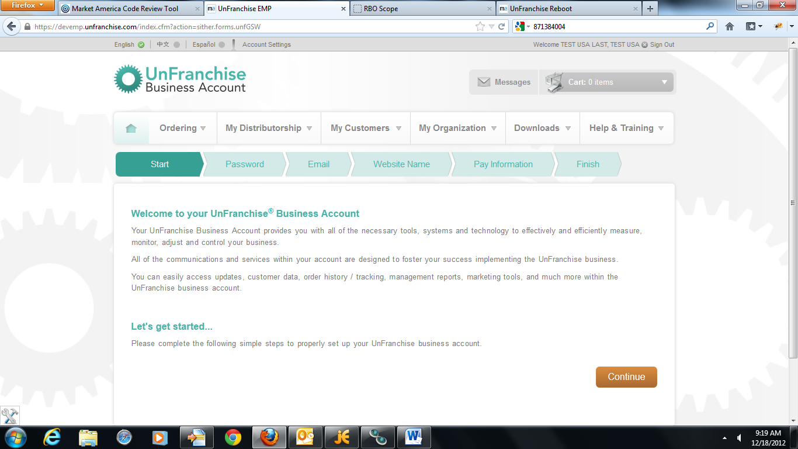
Getting Started!
Notes:
Add at the top “Getting Started”

Slide 19
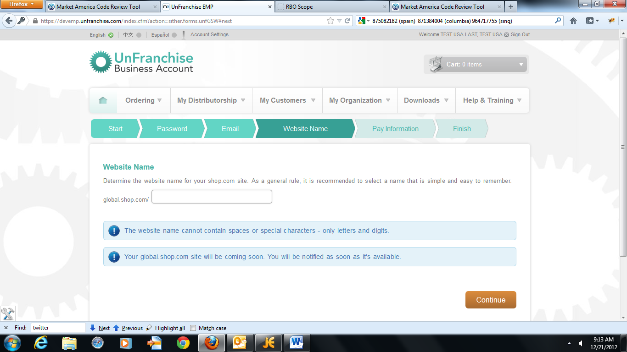
marc

Slide 20
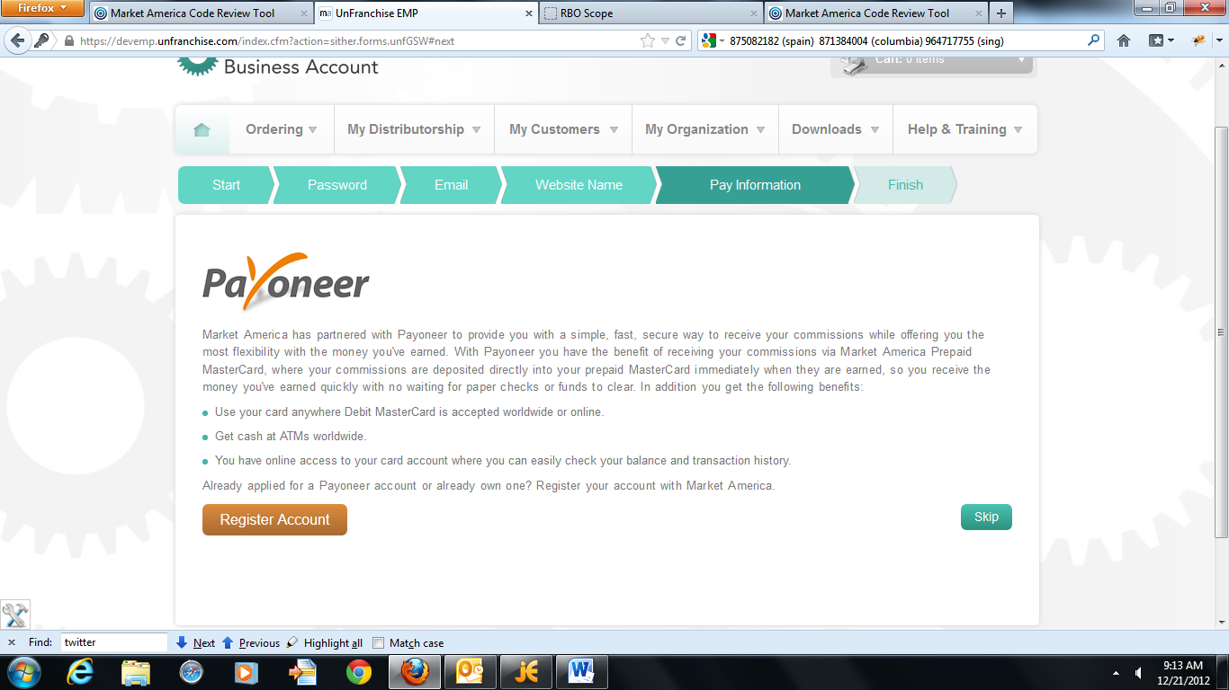

Slide 21
What is Payoneer
Payoneer provides a simple, fast, secure way to receive your commissions while offering you the most flexibility with the money you’ve earned.
With Payoneer you have the benefit of receiving commissions via Market America Prepaid MasterCard, where your commission are deposited directly into your prepaid Master Card immediately when they are earned, so you receive the money you’ve earned quickly with no waiting for paper checks or funds to clear.

Slide 22
What is Payoneer
Use your card anywhere Debit MasterCard is accepted worldwide or online..
Get cash at ATM’s worldwide.
You have access to your card account where you can easily heck your balance and transaction history.

Slide 23
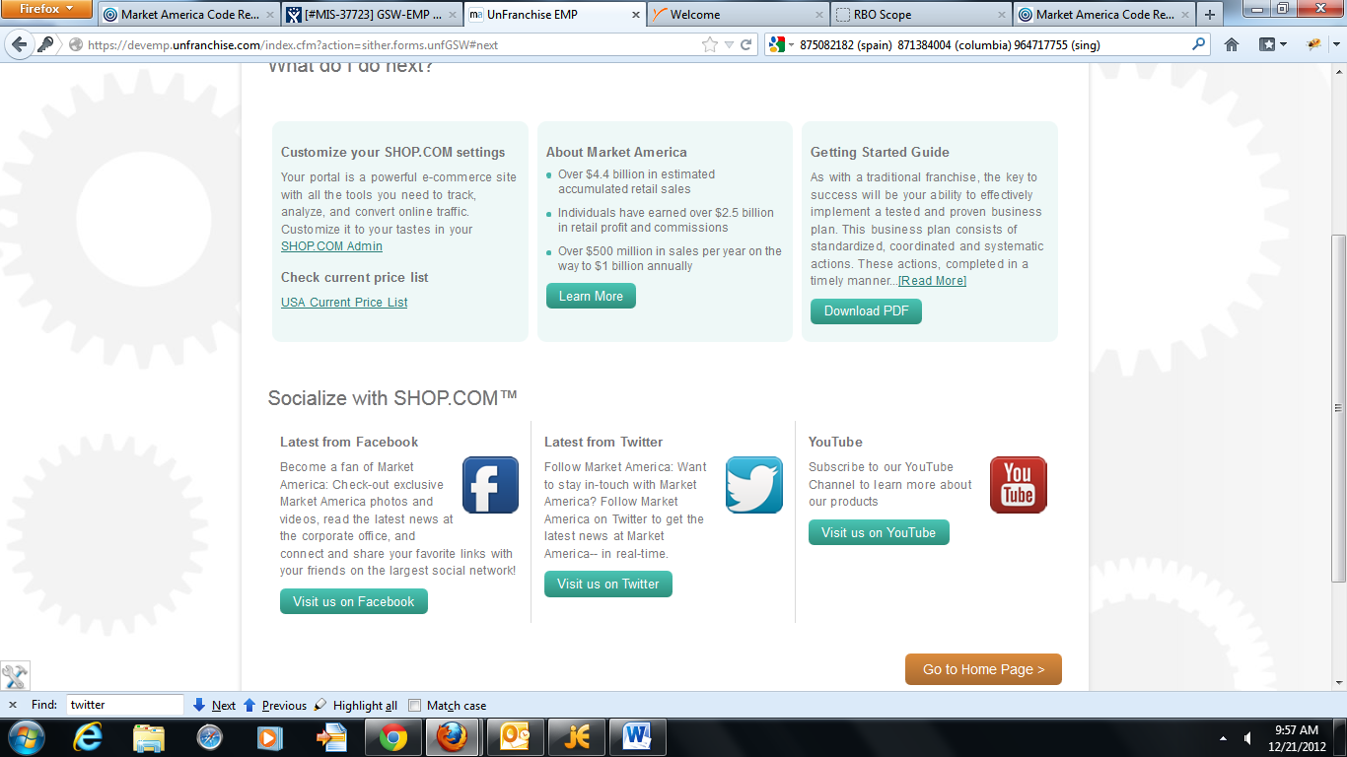

Slide 24
Shipping
For Spain, £8 flat fee per order regardless of size.
For Latin America, 12% of distributor cost

Slide 25
Bongo International provides you a US or Euro Address that you can ship orders to, then Bongo will ship that to your international address.
Bongo also will allow you to schedule (consolidate) shipments to help reduce shipping costs.

Slide 26
2
As an EMP Distributor, register with Bongo (on all SHOP Sites) and then schedule all your shipments to be sent in one package versus shipping multiple packages.
Latin America can use their US address to consolidate their shipments.
Spain EMP’s, Bongo gives you a Euro address that our their UK products can consolidated and shipped to.
Delivered safely to your local address within 1-5 days from your US or EU address.

Slide 27
Benefits of EMP Program
Purchase MA/UK Products (Latin America will order US Products and Spain will order UK Products.
EMP’s can drop ship to other EMP and market countries through their back office.
EMP’s can sponsor other EMP and market country distributors

Slide 28
Benefits of EMP Program
EMP’s will be able to earn BV Commissions
EMP’s will earn a referral bonus on each product sale
Enables us to monitor sales and fully launch in those countries based upon growth.
Latin America BV is unified with the America’s BV (US, CAN, MEX). Spain BV is unified with the UK.

Slide 29
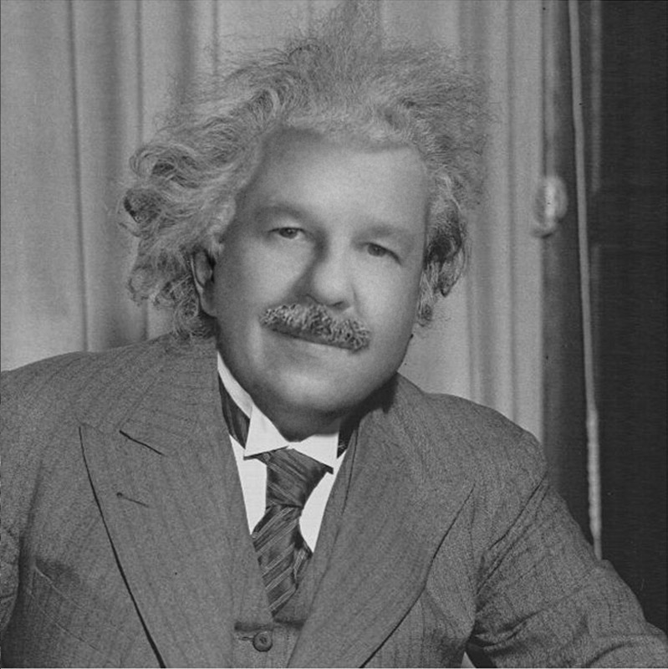
BINOMIAL EXPANSION FORMULA
(n+1) * Io = number of distributors in organization

Slide 30
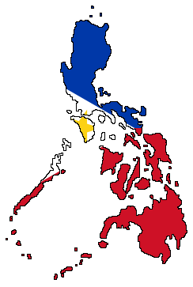
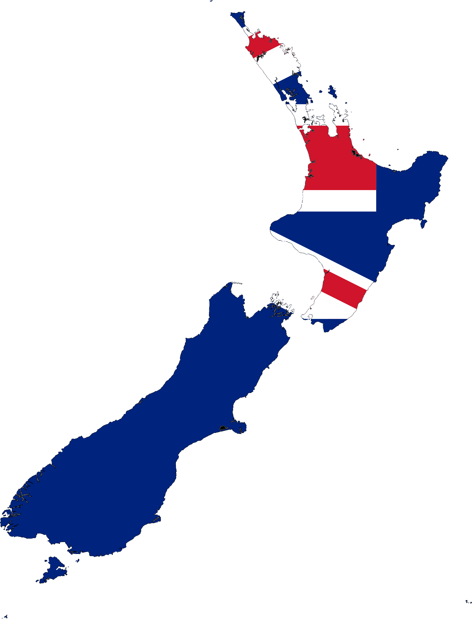
Coming Soon!
Philippines
Panama
Singapore
New Zealand

Slide 31
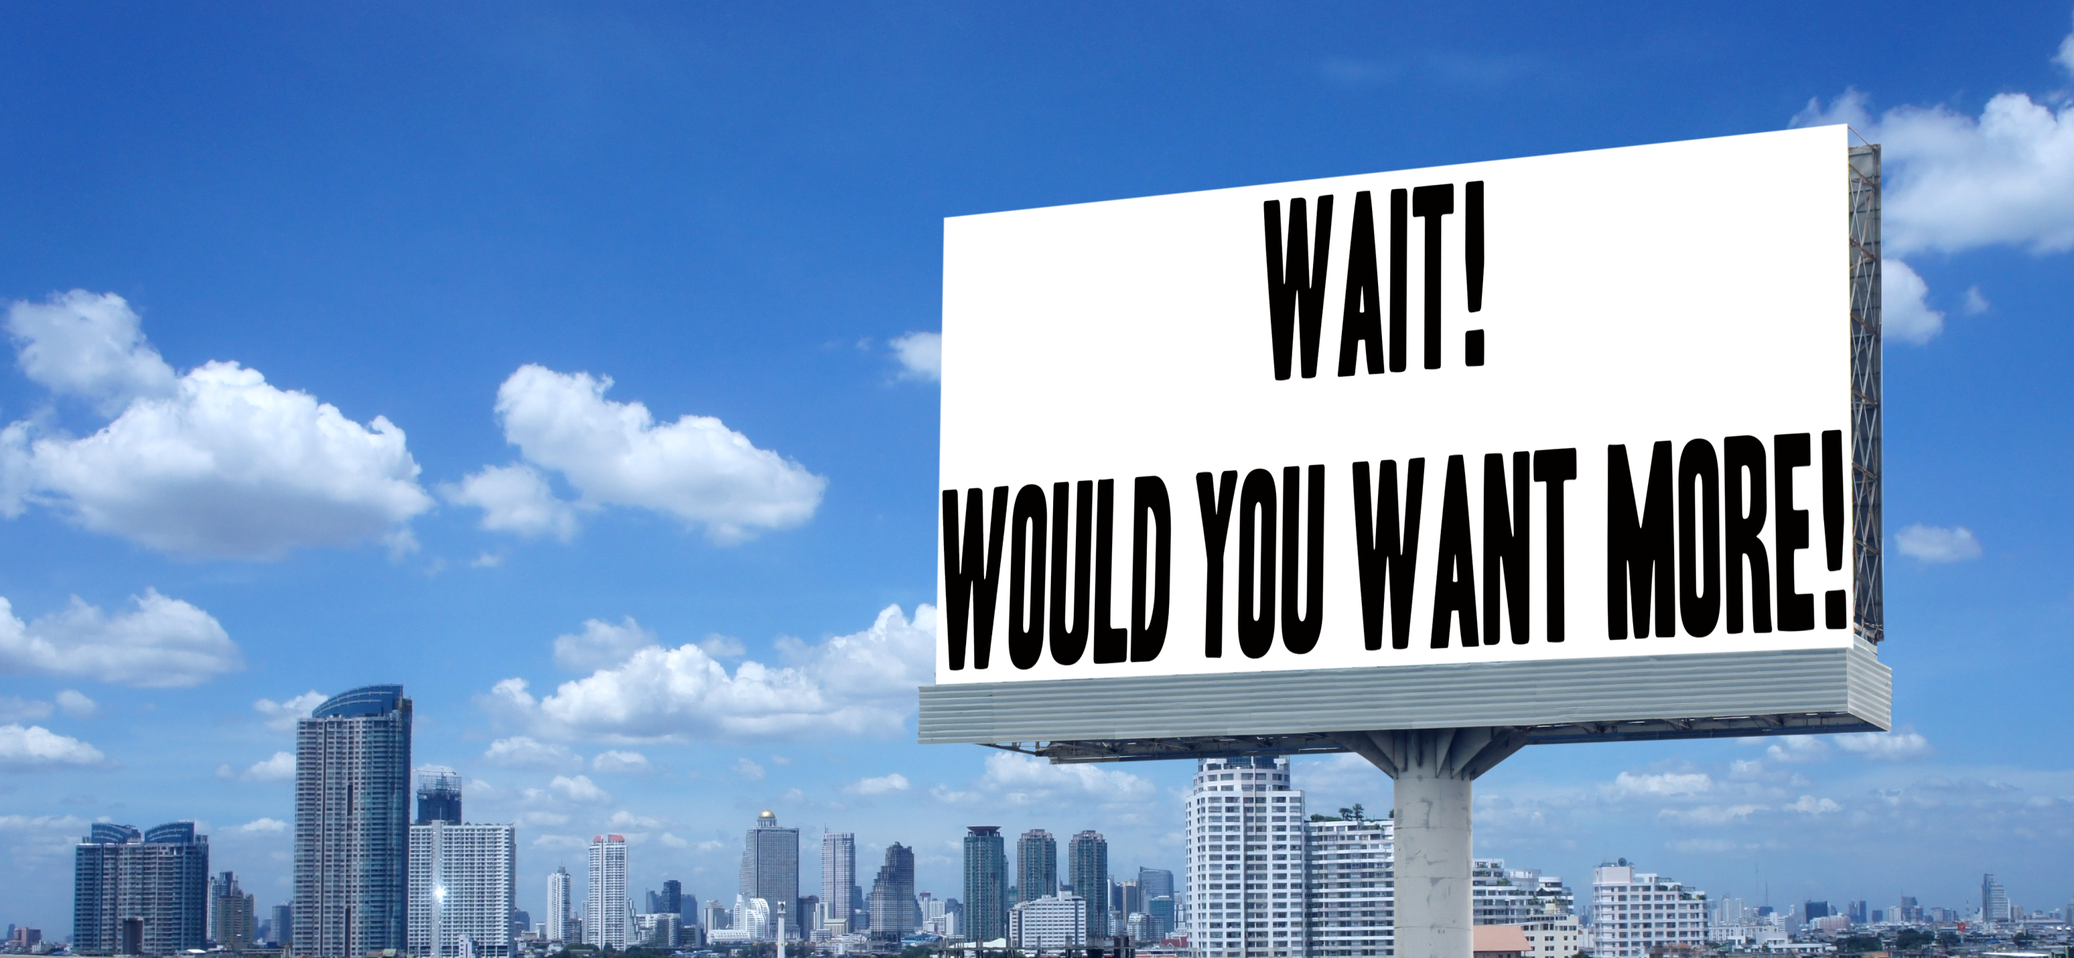

Slide 32
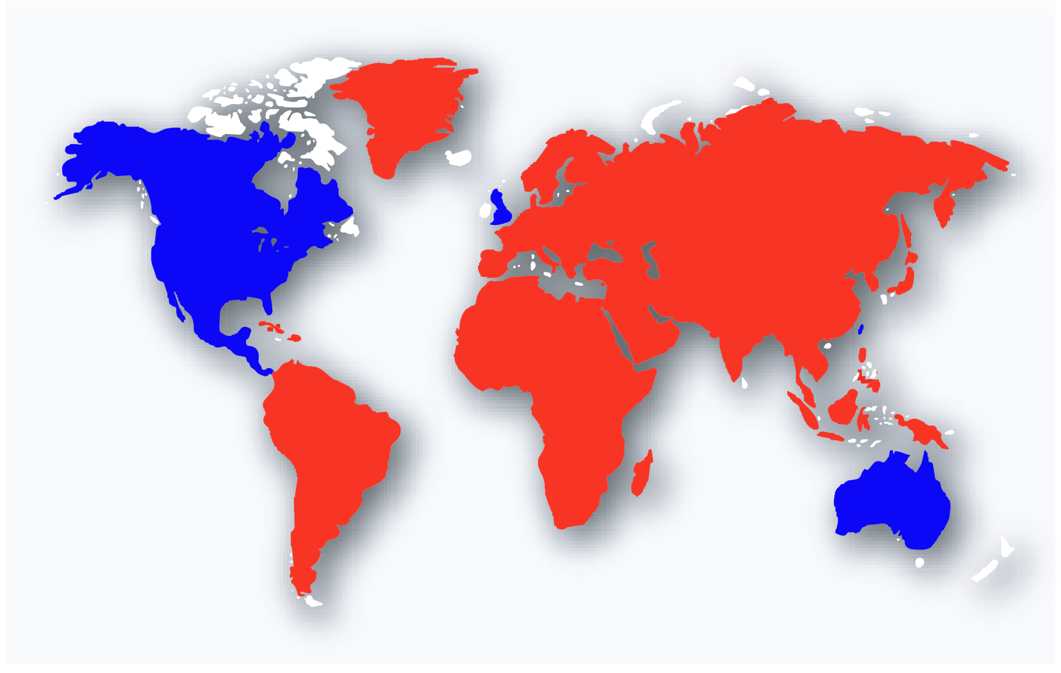
EMP Markets

Slide 37
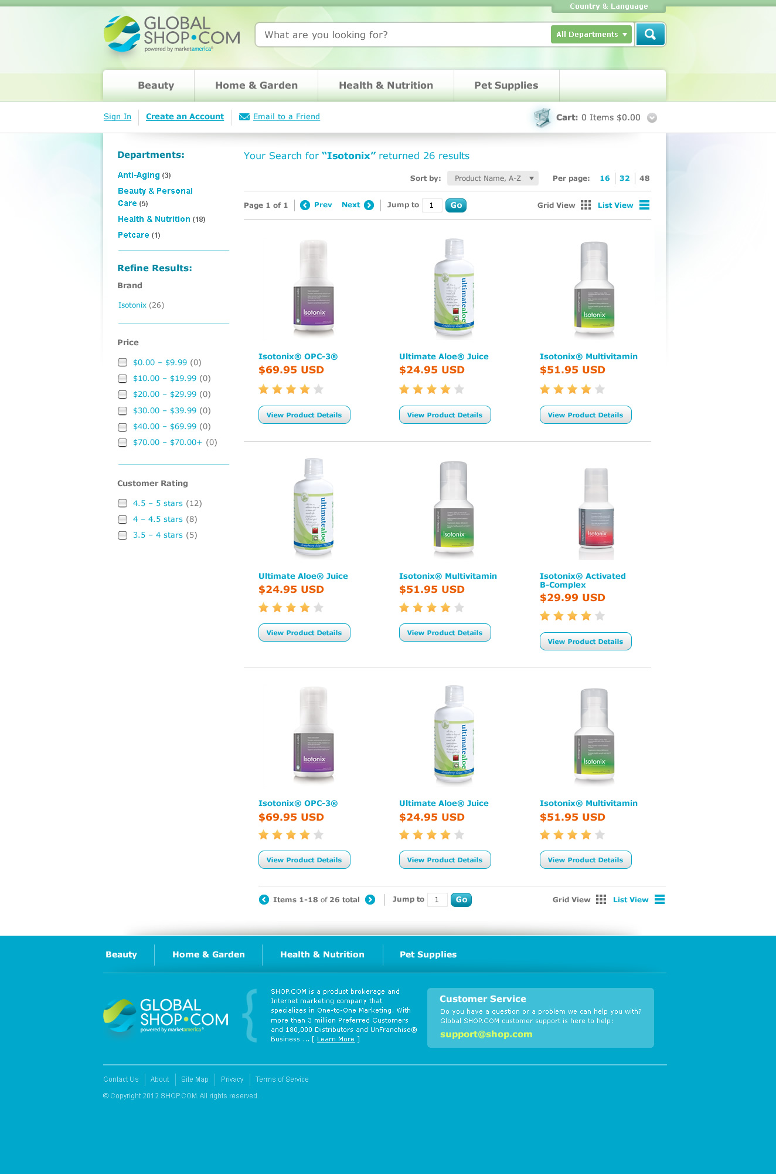

Slide 38
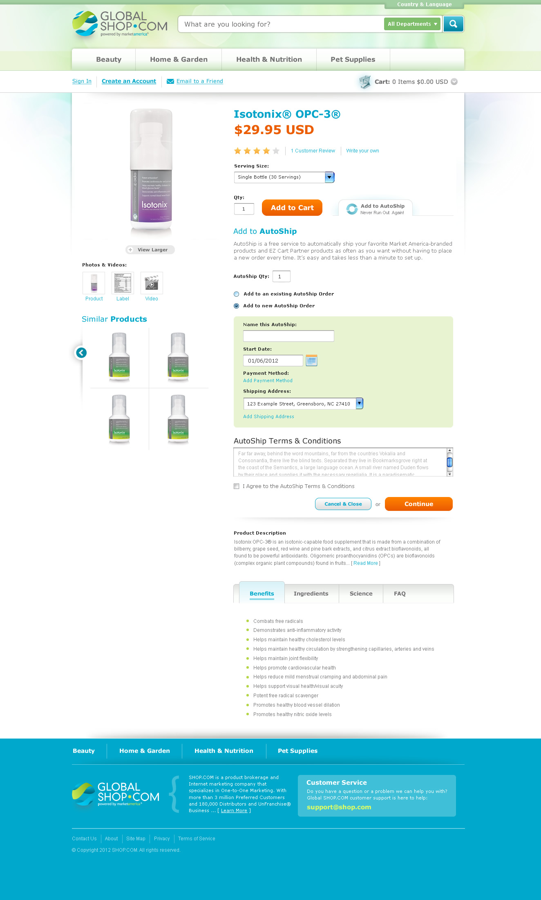

Slide 39
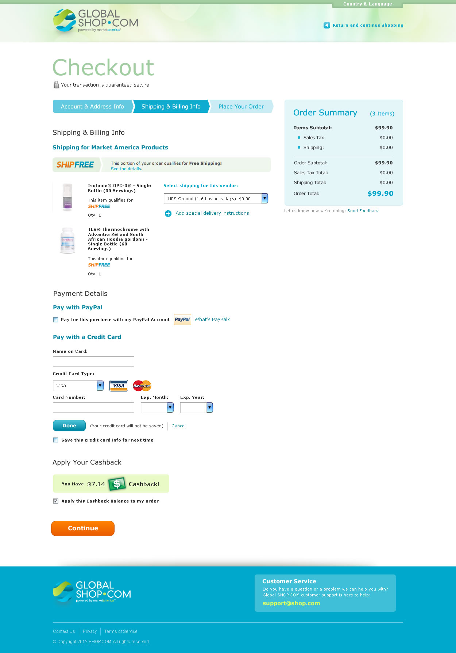
Global Customers also experience the quick and easy Checkout as your current customers receive. Making it easy for your international customers to shop and go without all the hassle.

Slide 40
What About Shipping?
Shipping in EU markets, orders over ₤30, FREE SHIPPING!
All other Countries:
Orders over $50 shipping is FREE!

Slide 41
Benefits of Global SHOP.COM
Expansion of customer base internationally
Expand your customer base outside of market countries to Global SHOP.COM
Send EMP Customers to place online orders
Earn referral bonuses for purchases
All BV gets credited to your home country

Slide 42
Want to order a product that’s not in your country?

Slide 43
Benefits of Global SHOP.COM
You as a distributor could order MA/UK Brands for personal consumption.
Distributors in our existing international markets (TW, HK, AU, MX and CA) now can purchase every MA Branded product through personal consumption on Global.SHOP.COM
Earn More BV, Commissions and Referral Bonuses!

Slide 44
Other Benefits of Global SHOP.COM
All Distributors will get their very own Global.SHOP.COM/xxxxx address
http://global.shop.com/marc

Slide 45
EMP Breakout Friday Night – 9:15

